Slide 1
Unit 4
Central Processing Unit and Control Unit

Slide 2
Introduction; Register Organization; Stack Organization; Instruction Format; Addressing Modes; Data Transfer and Manipulation; RISC and CISC.

Slide 3
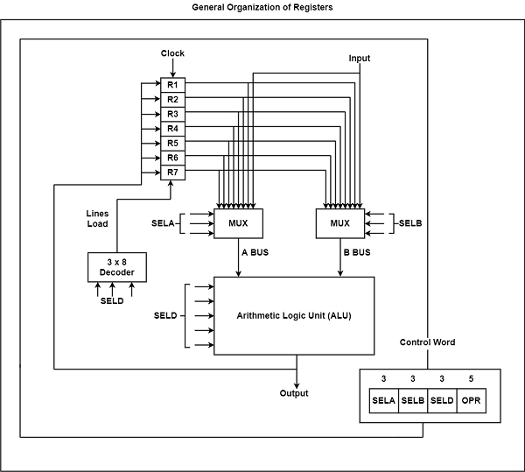
Register Organisation

Slide 4
Encoding of Register Selection Field
Binary Code | SELA | SELB | SELD
000 | Input | Input | None
001 | R1 | R1 | R1
010 | R2 | R2 | R2
011 | R3 | R3 | R3
100 | R4 | R4 | R4
101 | R5 | R5 | R5
110 | R6 | R6 | R6
111 | R7 | R7 | R7

Slide 5
Encoding of ALU Operations
OPR Select | Operation | Symbol
00000 | Transfer A | TSFA
00001 | Increment A | INCA
00010 | Add A + B | ADD
00101 | Subtract A - B | SUB
00110 | Decrement A | DECA
01000 | ADD A and B | AND
01010 | OR A and B | OR
01100 | XOR A and B | XOR
01110 | Complement A | COMA
10000 | Shift right A | SHRA
11000 | Shift left A | SHLA

Slide 6
ALU Micro-Operations
Micro-operation | SELA | SELB | SELD | OPR | Control Word
R1 ← R2 – R3 | R2 | R3 | R1 | SUB | 010 | 011 | 001 | 00101
R4 ← R4 ∨ R5 | R4 | R5 | R4 | OR | 100 | 101 | 100 | 01010
R6 ← R6 + R1 | - | R6 | R1 | INCA | 110 | 000 | 110 | 00001
R7 ← R1 | R1 | - | R7 | TSFA | 001 | 000 | 111 | 00000
Output ← R2 | R2 | – | None | TSFA | 010 | 000 | 000 | 00000
Output ← Input | Input | - | None | TSFA | 000 | 000 | 000 | 00000
R4 ← shl R4 | R4 | - | R4 | SHLA | 100 | 000 | 100 | 11000
R5 ← 0 | R5 | R5 | R5 | XOR | 101 | 101 | 101 | 01100

Slide 7
Control word is defined as a word whose individual bits represent the various control signal. Therefore each of the control steps in the control sequence of an instruction defines a unique combination of 0s and 1s in the CW.
In a control word various control signals are represented by its individual bits. It is a set of micro-instructions in a micro-routine. It is used in control data register in any instruction cycle.
It consists of:
branch conditions
flags
control signal field
next microinstruction field
control data register size = size of control word

Slide 8
Stack Organisation
A stack is an ordered linear list in which all insertions and deletions are made at one end, called top.
It usesLast In First Out (LIFO) access method which is the most popular access method in most of the CPU.
A register is used to store the address of the topmost element of the stack which is known as Stack pointer (SP) because its value always points at the top item in the stack.
In this organisation, ALU operations are performed on stack data.

Slide 9
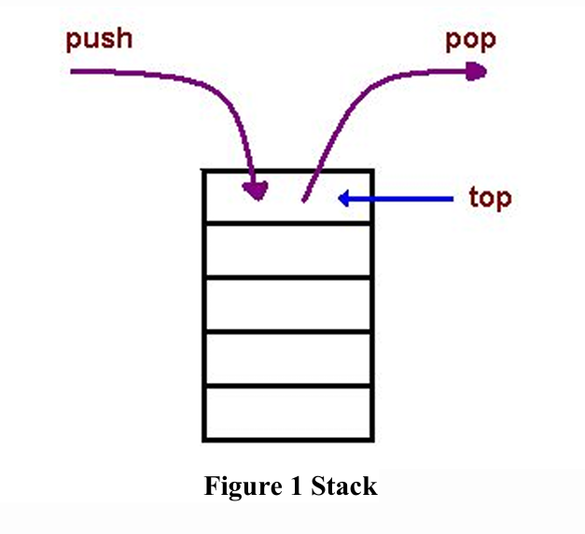
The main two operations that are performed on the operands of the stack are Push and Pop.
These two operations are performed from one end only.
● Push operation - The operation of inserting an item onto a stack is called push operation.
● Pop operation- The operation of deleting an item onto a stack is called pop operation

Slide 10
Applications
● Evaluation of mathematical expressions using Reverse Polish Notation
● To reverse a word. A given word is pushed to stack - letter by letter - and then poped out letters from the stack.
● An "undo" mechanism in text editors; this operation is accomplished by keeping all text changes in a stack
● Backtracking. This is a process when it is required to access the most recent data element in a series of elements.
● Language processing etc.

Slide 11
There are two types of stack organisation which are used in the computer hardware.
● Register stack- It is built using register
● Memory stack- It is a logical part of memory allocated as stack. The logically partitioned part of RAM is used to implement stack.

Slide 12
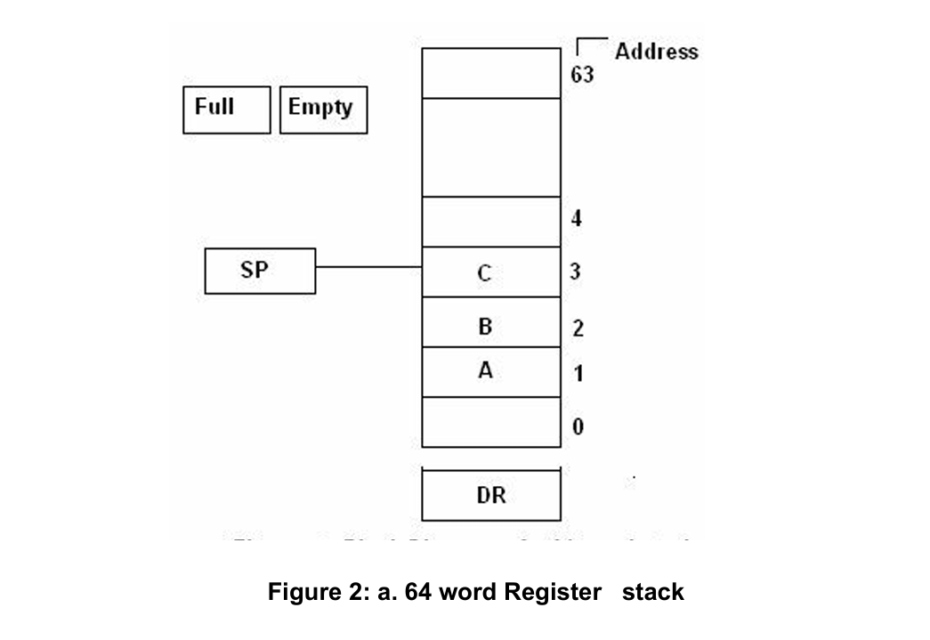
Register Stack

Slide 13
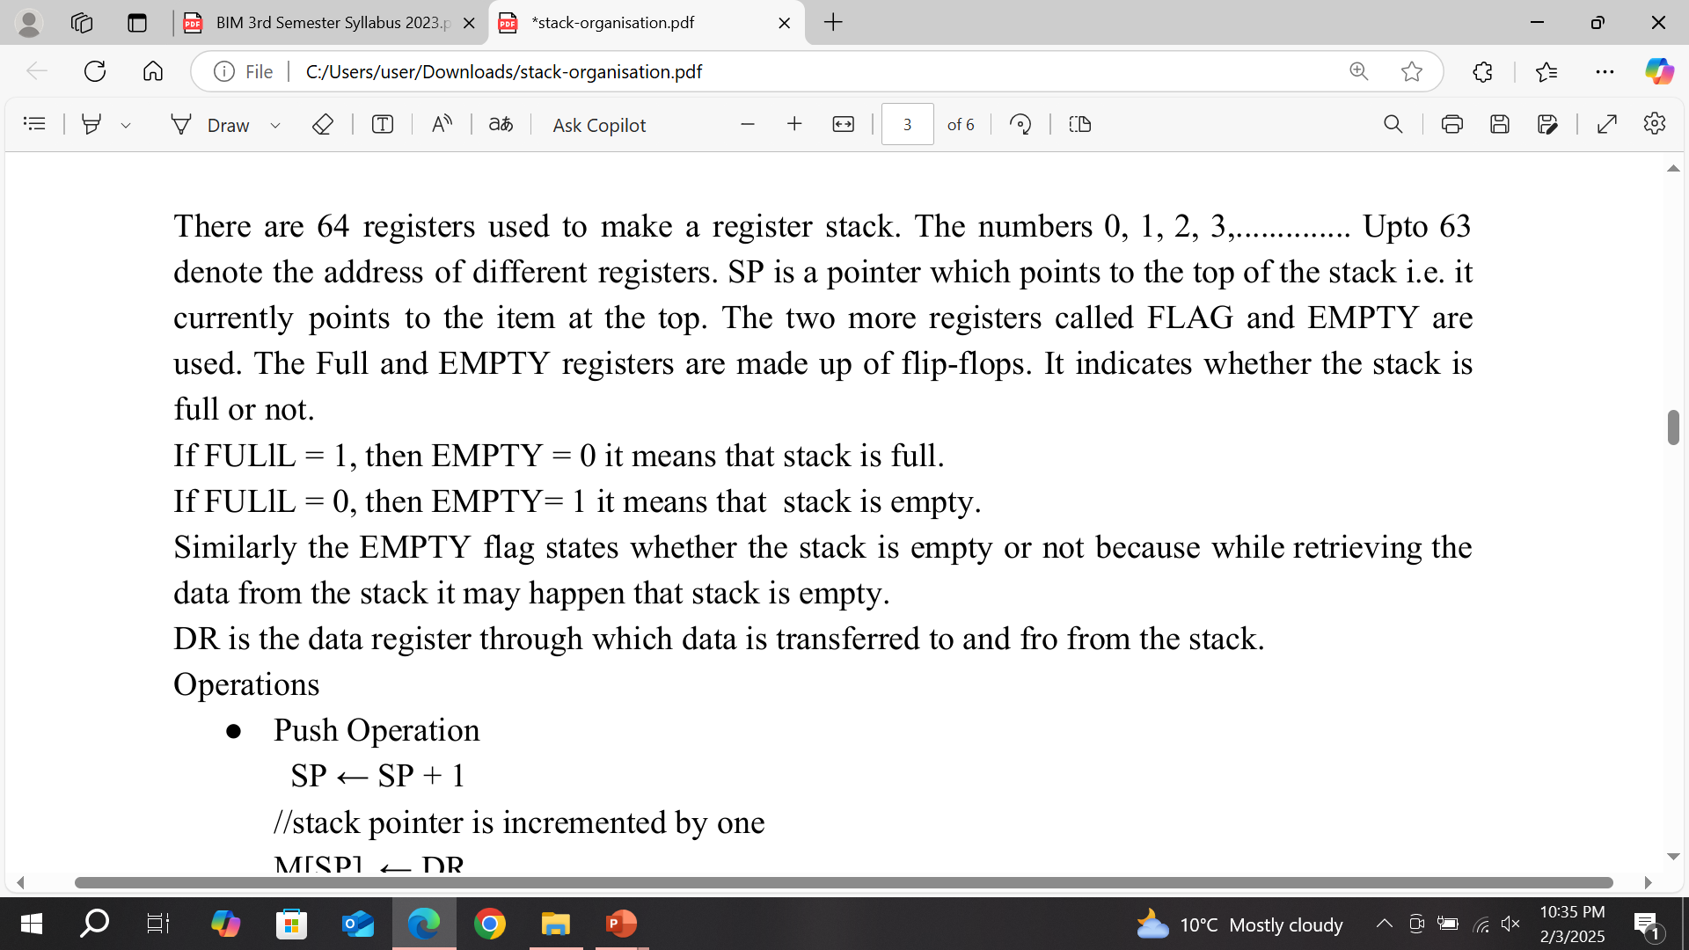

Slide 14
Operations
● Push Operation
SP ← SP + 1 //stack pointer is incremented by one
M[SP] ← DR // the content of the data register is stored at the current memory pointed by the stack pointer.
IF (SP = 0) then (FULL ←1)
(EMPTY ←0)
// The values of flag registers are set.
● Pop operation
DR ←M[SP] // the content of current memory pointed by the stack pointer is stored to data register
SP = SP - 1 //stack pointer is decremented by one
If (SP = 0) then ( EMPTY ←1)
FULL ←0

Slide 15
Since the address of 64 registers are numbered from0,1,2,3,..............Upto63. The binary value of 63 is 111111 which is of 6 bits.
When stack pointer is incremented after 63,it becomes 64 corresponding to the binary value 1000000 which is of 7-bits. But in this case the address of each register is of 6-bits, hence1 is discarded from the binary value of 64.
The stack pointer points to the 000000 address register. It implies that the stack is full.

Slide 16
Zero address instructions are used in registers stack organisation. The address that does not contain the address of the operands.
Example:
( a + b) * ( c + d )
Following are the instructions to execute it
Push a
Push b
Add. // Zero address instruction
Push c
Push d
Add. // Zero address instruction
Mul. // Zero address instruction

Slide 17
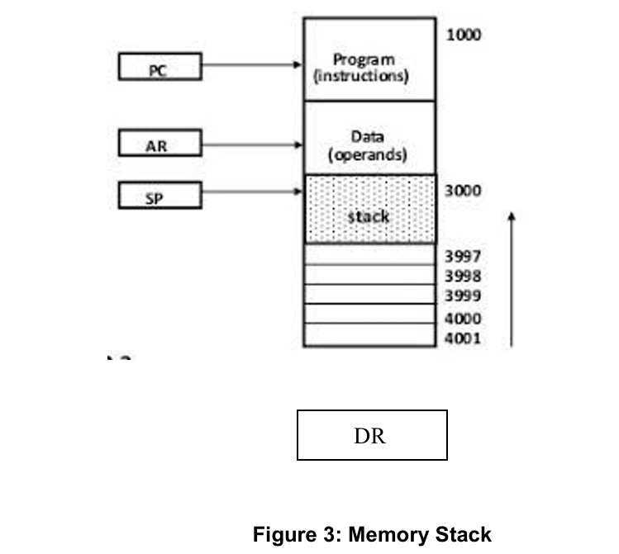
Memory stack - The RAM is divided into three logical parts.
● Program-The logical part of RAM where programs are stored. The program section address starts from 1000.
● Data-It is the logical part of RAM where data(operands) are stored. The data section address starts from 2000.
● Stack-It is the part of RAM used to implement stack. It’s address starts from 3000 and continues up to 4001.

Slide 18
Push operation. POP operation
SP ← SP - 1. DR ← M[SP]
M[SP]. ← DR. SP ← SP + 1

Slide 19
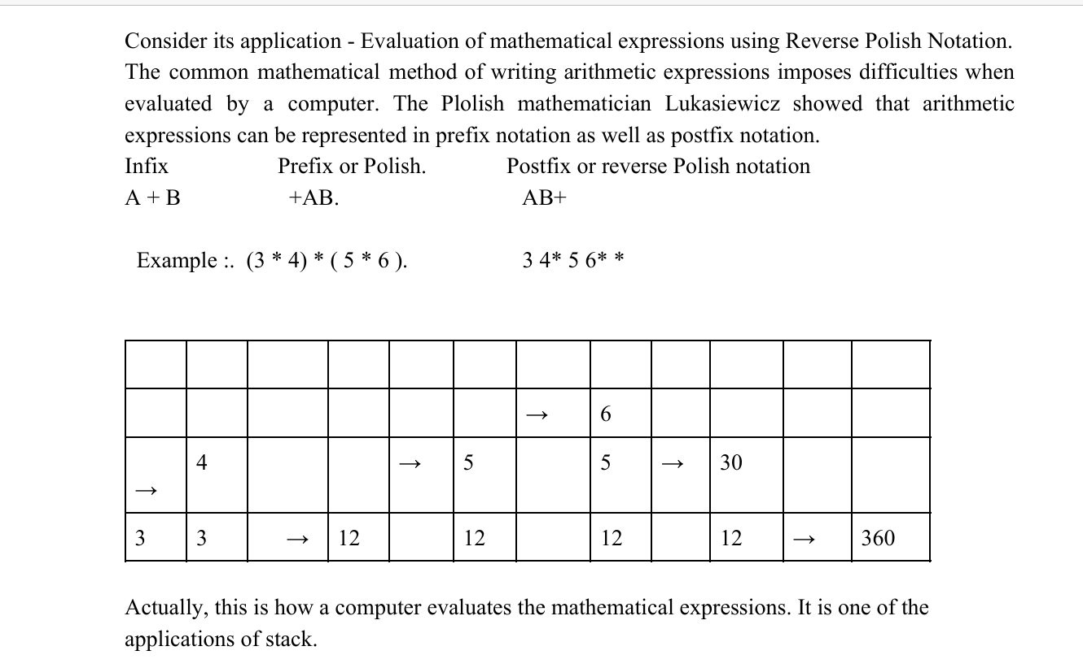

Slide 20
Instruction Format
In computer architecture, the instruction format is defined as standard machine instruction format that can be directly decoded and executed by the central processing unit (CPU).
The instruction format is simply a sequence of bits (binary 0 Or 1) contained in a machine instruction that defines the layout of the instruction.
The machine instruction contains number of bits (pattern of 0 and 1 ). These bits are grouped together called fields.
Each field of the machine instruction provides specific information to the CPU regarding the operation to be performed and the location of the data.
An instruction format is also defied as layout or pattern of bits in the machine instruction that directs the CPU to decode and execute the instruction.

Slide 21
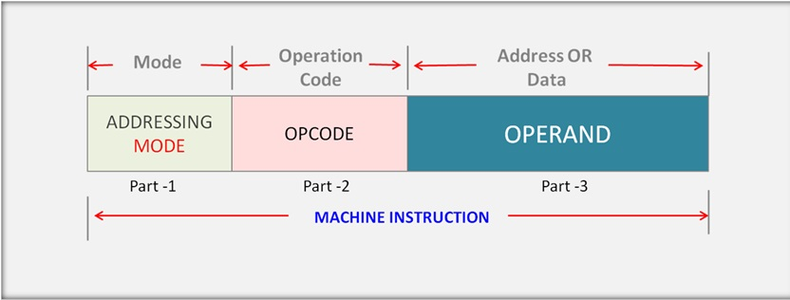

Slide 22
Addressing modes
Introduction:
The addressing modes help us specify the way in which an operand’s effective address is represented in any given instruction. Some addressing modes allow referring to a large range of areas efficiently, like some linear array of addresses along with a list of addresses. The addressing modes describe an efficient and flexible way to define complex effective addresses.
The programs are generally written in high-level languages, as it’s a convenient way in which one can define the variables along with the operations that a programmer performs on the variables. This program is later compiled so as to generate the actual machine code. A machine code includes low-level instructions.
A set of low-level instructions has operands and opcodes. An addressing mode has no relation with the opcode part. It basically focuses on presenting the address of the operand in the instructions.

Slide 23

Types of addressing modes:
Implied mode:
In the implied mode, the operands are implicitly specified in the definition of instruction.
For instance, the “complement accumulator” instruction refers to an implied-mode instruction. It is because, in the definition of the instruction, the operand is implied in the accumulator register. All the register reference instructions are implied-mode instructions that use an accumulator.
In a stack organized computer, Zero Address Instructions are implied mode instructions.
(since operands are always implied to be present on the top of the stack)

Slide 24
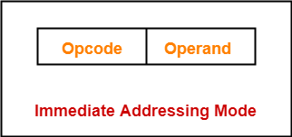
Immediate Mode
In the immediate mode, we specify the operand in the instruction itself. Or, in simpler words, instead of an address field, the immediate-mode instruction consists of an operand field.
An operand field contains the actual operand that is to be used in conjunction with an operation that is determined in the given instruction.
Examples-
ADD 10 will increment the value stored in the accumulator by 10.
MOV R #20 initializes register R to a constant value 20.

Slide 25
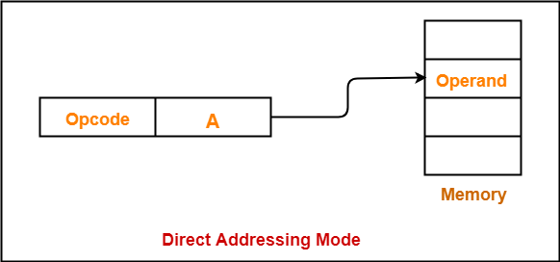
Direct Addressing Mode-
In this addressing mode,
The address field of the instruction contains the effective address of the operand.
Only one reference to memory is required to fetch the operand.
It is also called as absolute addressing mode.
Example:
ADD X will increment the value stored in
the accumulator by the value stored at
memory location X.
AC ← AC + [X]

Slide 26
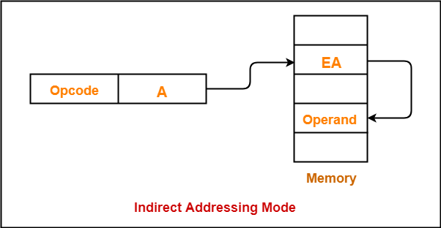
Indirect Addressing Mode-
In this addressing mode, the address field of the instruction specifies the address of memory location that contains the effective address of the operand.
Two references to memory are required to fetch the operand.
Example-
ADD X will increment the value stored
in the accumulator by the value stored
at memory location specified by X.
AC ← AC + [[X]]

Slide 27
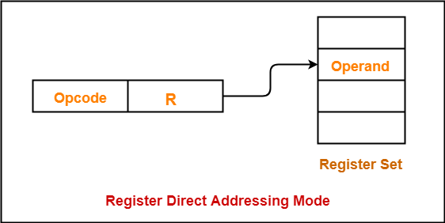
Register (Direct) Mode
In this addressing mode, the operand is contained in a register set.
The address field of the instruction refers to a CPU register that contains the operand.
No reference to memory is required to fetch the operand.
Example-
ADD R will increment the value stored in the accumulator by the content of register R.
AC ← AC + [R]
This addressing mode is similar to
direct addressing mode.
The only difference is address field
of the instruction refers to a CPU register
instead of main memory.

Slide 28
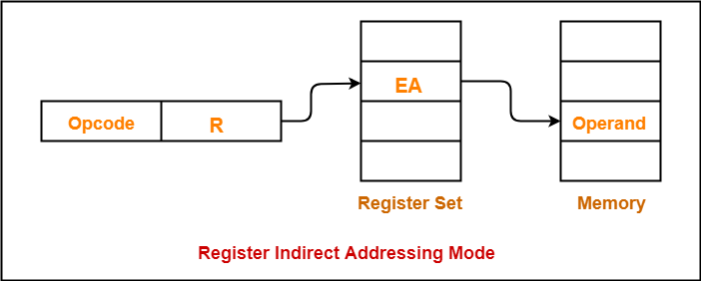
Register Indirect Mode
In this addressing mode, the address field of the instruction refers to a CPU register that contains the effective address of the operand.
In simpler words, any selected register would include the address of an operand instead of the operand itself.
Only one reference to memory is required to fetch the operand.
Example-
ADD R will increment the value stored in the accumulator by the content of memory location specified in register R.
AC ← AC + [[R]]
This addressing mode is similar to
indirect addressing mode.
The only difference is address field
of the instruction refers to a CPU register.

Slide 29
Autodecrement or the Autoincrement Mode
The Autodecrement or Autoincrement mode is very similar to the register indirect mode. The only exception is that the register is decremented or incremented before or after its value is used to access memory.
Autoincrement Mode:
This addressing mode is a special case of Register Indirect Addressing Mode where-
Effective Address of the Operand = Content of Register
In this addressing mode, after accessing the operand, the content of the register is automatically incremented by step size ‘d’.
Step size ‘d’ depends on the size of operand accessed.
Only one reference to memory is required to fetch the operand.

Slide 30
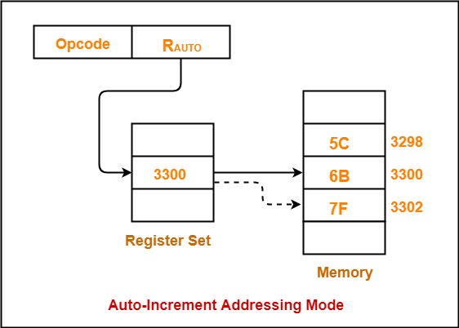
Assume operand size = 2 bytes.
Here,
After fetching the operand 6B, the instruction register R_{AUTO} will be automatically incremented
by 2.
Then, updated value of R_{AUTO} will be
3300 + 2 = 3302.
At memory address 3302, the next operand
will be found.
NOTE-
In auto-increment addressing mode,
First, the operand value is fetched.
Then, the instruction register R_{AUTO} value is incremented
by step size ‘d’.

Slide 31
Auto-Decrement Addressing Mode-
This addressing mode is again a special case of Register Indirect Addressing Mode where-
Effective Address of the Operand = Content of Register – Step Size
In this addressing mode, first the content of the register is decremented by step size ‘d’.
Step size ‘d’ depends on the size of operand accessed.
After decrementing, the operand is read.
Only one reference to memory is required to fetch the operand

Slide 32
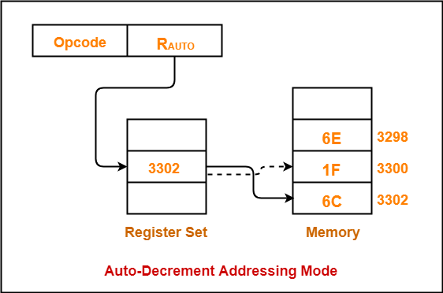
Assume operand size = 2 bytes.
Here,
First, the instruction register R_{AUTO}
will be decremented by 2.
Then, updated value of R_{AUTO} will be
3302 – 2 = 3300.
At memory address 3300, the operand will
be found.
NOTE-
In auto-decrement addressing mode,
First, the instruction register R_{AUTO}
value is decremented by step size ‘d’.
Then, the operand value is fetched.

Slide 33
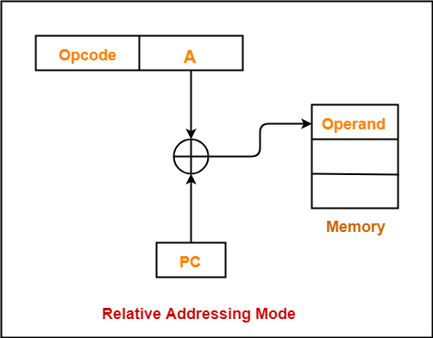
Relative Addressing Mode-
In this addressing mode, effective address of the operand is obtained by adding the content of program counter with the address part of the instruction.
Effective Address = Content of Program Counter + Address part of the instruction
Program counter (PC) always contains the address of the next instruction to be executed.
After fetching the address of the instruction, the value of program counter immediately increases.
The value increases irrespective of whether
the fetched instruction has completely executed or not.

Slide 34
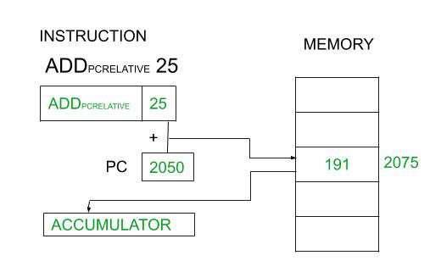

Slide 35
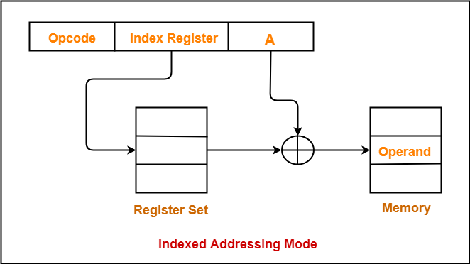
Indexed Addressing Mode-
In this addressing mode,
Effective address of the operand is obtained by adding the content of index register with the address part of the instruction.
Effective Address
= Content of Index Register + Address part of the instruction

Slide 36
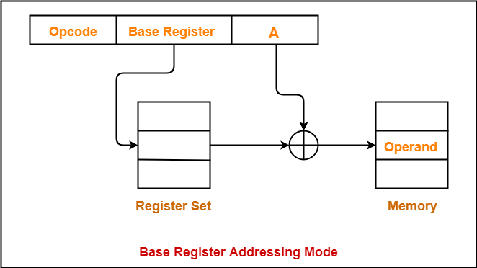
Base Register Addressing Mode-
In this addressing mode, effective address of the operand is obtained by adding the content of base register with the address part of the instruction.
Effective Address = Content of Base Register + Address part of the instruction

Slide 37
Applications of Addressing Modes-
Addressing Modes | Applications
Immediate Addressing Mode | To initialize registers to a constant value
Direct Addressing Mode and Register Direct Addressing Mode | To access static data To implement variables
Indirect Addressing Mode and Register Indirect Addressing Mode | To implement pointers because pointers are memory locations that store the address of another variable To pass array as a parameter because array name is the base address and pointer is needed to point the address
Relative Addressing Mode | For program relocation at run time i.e. for position independent code To change the normal sequence of execution of instructions For branch type instructions since it directly updates the program counter
Index Addressing Mode | For array implementation or array addressing For records implementation
Base Register Addressing Mode | For writing relocatable code i.e. for relocation of program in memory even at run time For handling recursive procedures
Auto-increment Addressing Mode and Auto-decrement Addressing Mode | For implementing loops For stepping through arrays in a loop For implementing a stack as push and pop

Slide 38
Data transfer and manipulation
Data transfer instructions move data from one place in the computer to another without changing the data content. The most common transfers are between memory and processor registers, between processor registers and input or output, and between the processor registers themselves.
The load instruction is used to transfer for memory to a processor register, usually an accumulator.
The store instruction is used to transfer data to memory.
The move instruction is used to transfer data from one register to other. It has also been used for data transfers between CPU registers and memory or between two memory words.
The exchange instruction swaps information between two registers or a register and a memory word.
The input and output instructions transfer data among processor registers and input or output terminals.
The push and pop instructions transfer data between processor registers and a memory stack.

Slide 39
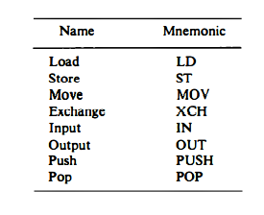
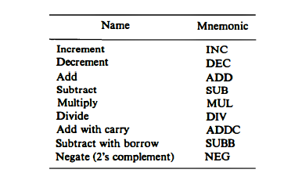
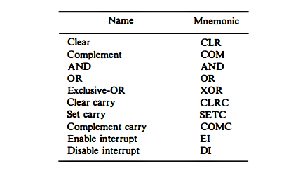
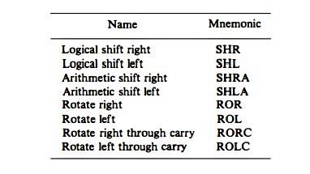

Slide 40
Data Manipulation Instructions:
Data manipulation instructions perform operations on data and provide the computational capabilities for the computer. The data manipulation instructions in a typical computer are usually divided into three basic types:
Arithmetic instructions
Logical and bit manipulation instructions
Shift instructions

Slide 41
Arithmetic Instructions
The four basic arithmetic operations are addition, subtraction, multiplication, and division. Most computers provide instructions for all four operations.
Some small computers have only addition and possibly subtraction instructions. The multiplication and division must then be generated by means of software subroutines.
The increment instruction adds 1 to the value stored in a register or memory word. The decrement instruction subtracts 1 from a value stored in a register or memory word.
The instruction "add with carry" performs the addition on two operands plus the value of the carry from the previous computation.
Similarly, the "subtract with borrow" instruction subtracts two words and a borrow which may have resulted from a previous subtract operation.
The negate instruction forms the 2' s complement of a number, effectively reversing the sign of an integer when represented in the signed-2's complement form.

Slide 42
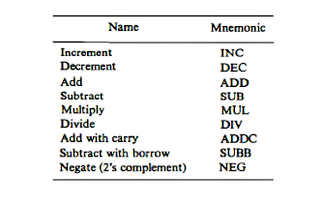

Slide 43
Logical and Bit Manipulation Instructions
Logical instructions perform binary operations on strings of bits stored in registers. They are useful for manipulating individual bits or a group of bits that represent binary-coded information. The AND instruction is used to clear a bit or a selected group of bits of an operand. The OR instruction is used to set a bit or a selected group of bits of an operand. Similarly, the XOR instruction is used to selectively complement bits of an operand. Individual bits such as a carry can be cleared, set, or complemented with appropriate instructions.

Slide 44
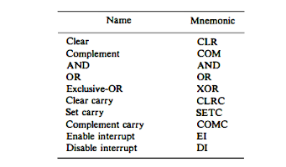

Slide 45
Shift Instructions
Instructions to shift the content of an operand are quite useful and are often provided in several variations. Shifts are operations in which the bits of a word are moved to the left or right. The bit shifted in at the end of the word determines the type of shift used. Shift instructions may specify either logical shifts, arithmetic shifts, or rotate-type operations. In either case the shift may be to the right or to the left.
The logical shift inserts 0 to the end bit position. The end position is the leftmost bit for shift right and the rightmost bit position for the shift left.
The arithmetic shift-right instruction must preserve the sign bit in the leftmost position. The sign bit is shifted to the right together with the rest of the number, but the sign bit itself remains unchanged. This is a shift-right operation with the end bit remaining the same. The arithmetic shift-left instruction inserts 0 to the end position and is identical to the logical shift-left instruction.
The rotate instructions produce a circular shift. Bits shifted out at one end of the word are not lost as in a logical shift but are circulated back into the other end.

Slide 46
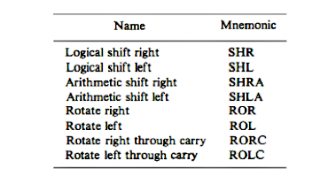

Slide 47
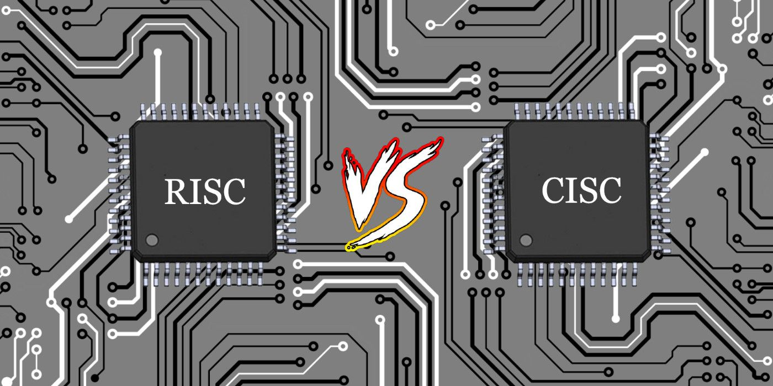
Risc vs cisc

Slide 48
CISC: It stands for Complex Instruction Set Computer. These processors offer the users, hundreds of instructions of variable sizes.
CISC architecture includes a complete set of special-purpose circuits that carry out these instructions at a very high speed. These instructions interact with memory by using complex addressing modes.
CISC processors reduce the program size and hence lesser number of memory cycles are required to execute the programs. This increases the overall speed of execution. Examples: Intel architecture, AMD

Slide 49
This architecture was introduced in the 1970s by Intel Corporation when the earliest computers focused on enhancing CPU speed by minimizing the number of instructions per program.
This objective was achieved by combining multiple simple commands into one complex instruction.
In the pet analogy, the command ‘run’ can be referred to as a CISC instruction. When you instruct your pet to run, it performs a set of instructions such as ‘track the toy,’ then ‘pick the toy up,’ followed by ‘get back to the owner,’ and finally, ‘hand over the toy to the owner.’ As the example reveals, it is a lot more convenient and faster to give a single ‘run’ instruction to your pet rather than giving it four independent commands. This is exactly why tech companies such as Intel preferred designing CISC processors in the initial computing years.

Slide 50
Let’s understand this with a simple CISC ADD instruction, which requires two inputs:
Memory locations of two numbers essential for an addition
Perform addition and store the result in the first memory location
| ADD 1800, 1801
The ADD instruction picks up numbers from memory locations 1800 and 1801 or registers. Later, the picked-up numbers are added and eventually stored in location 1800.
Here, a single ADD instruction performs multiple low-level operations, such as loading numbers from memory, performing the arithmetic ADD operation, and then storing the result in another memory.
The compiler’s workload is reduced significantly here as high-level instructions are easily computed and stored. Moreover, these instructions consume minimum RAM as the hardware takes care of most tasks while decoding the instructions in the beginning stages.

Slide 51
Hence, in CISC architectures, the CPU is entitled to put in more work to perform a single instruction. As the execution of the instruction takes more time, clock speeds are compromised. Moreover, CISC operations require more transistors to decode complex instructions.
Commonly known examples of CISC processors are AMD, Intel x86, VAX, and System/360.

Slide 52
RISC ‘Reduced Instruction Set Computer.’
It is a type of microprocessor architecture that uses a small set of instructions of uniform length.
These are simple instructions that are generally executed in one clock cycle. RISC chips are relatively simple to design and inexpensive.
The setback of this design is that the computer has to repeatedly perform simple operations to execute a larger program having a large number of processing operations.
These were introduced in the 1980s by David Patterson and John Hennessy to overcome the complexities of CISC processors.
RISC processors work with more instructions; however, the number of cycles an instruction may take to execute is minimized.
In general terms, a RISC machine takes one CPU cycle to complete one instruction. Examples: SPARC, POWER PC, etc.

Slide 53
Let’s consider the same ADD instruction and look at how RISC devices accomplish it. To begin with, RISC machines do not execute the ADD instruction in one step. Instead, it is broken down into multiple steps.
For example, you need to load the numbers from memory through a LOAD instruction, followed by an ADD instruction that adds them, and finally, a STORE instruction that stores the result in memory.

Slide 54
Load X, 1600
Load Y, 1601
ADD X, Y
Store 1600, X
In this example, the ‘Load’ instruction loads data at memory location 1600 into register X.
Similarly, the second ‘Load’ instruction picks up data from 1601 and loads it into register Y.
Later, the values in registers X and Y are added.
Lastly, the result X of addition is stored at memory location 1600 or any other location.
It is worth noting that operations in RISC-type processors are performed on ‘registers’ rather than directly on memory.

Slide 55
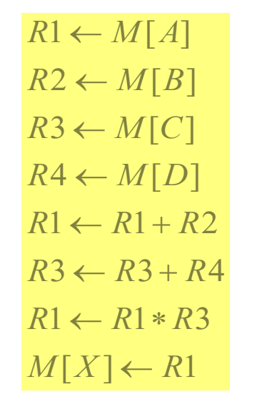
Only use LOAD and STORE instruction when communicating between memory and CPU •
All other instructions are executed within the registers of the CPU without referring to memory
Program to evaluate X = ( A + B ) * ( C + D )
LOAD R1, A
LOAD R2, B
LOAD R3, C
LOAD R4, D
ADD R1, R1, R2
ADD R3, R3, R4
MUL R1, R1, R3
STORE X, R1
Load instruction transfers the operand from memory to CPU Register. •
Add and Multiply operations are executed with data in the registers without accessing the memory.
Result is then stored in the memory with store information.
The primary instruction set of a RISC processor includes LOAD and STORE instructions for communication between memory and the CPU. Other computational instructions (such as ADD, SUB, and MUL) operate entirely within the CPU registers.
Here, A, B, C, and D represent memory locations, and X stores the result. The entire computation occurs within the registers of the CPU 1.

